Slide 1


Choosing to Trust God:
A Journey of Faith
Notes:
The Penultimate Chapter of Jerry Bridges' book "Trusting God" is titled "Choosing to Trust God." In this chapter, Bridges emphasizes the importance of actively choosing to trust God, particularly in difficult or uncertain times. He argues that trust in God is not merely a passive state but a deliberate decision, an act of the will.
Bridges discusses how trusting God is a fundamental aspect of the Christian faith, and it influences how believers respond to life's challenges and adversities. He uses biblical examples and personal anecdotes to illustrate how choosing to trust God can transform one’s approach to life, leading to peace and resilience.
The chapter delves into the practical aspects of building and maintaining trust in God. Bridges offers guidance on how to nurture this trust through prayer, meditation on Scripture, and the cultivation of a heart that is attuned to God's presence and promises.
He encourages readers to reflect on God’s sovereignty, wisdom, and love as reasons to trust Him fully.
"Choosing to Trust God" ultimately calls readers to reflect on their own faith journeys, challenging them to make a conscious choice to trust God in all circumstances, thereby deepening their relationship with Him and finding comfort in His sovereign control over all aspects of life.

Slide 2
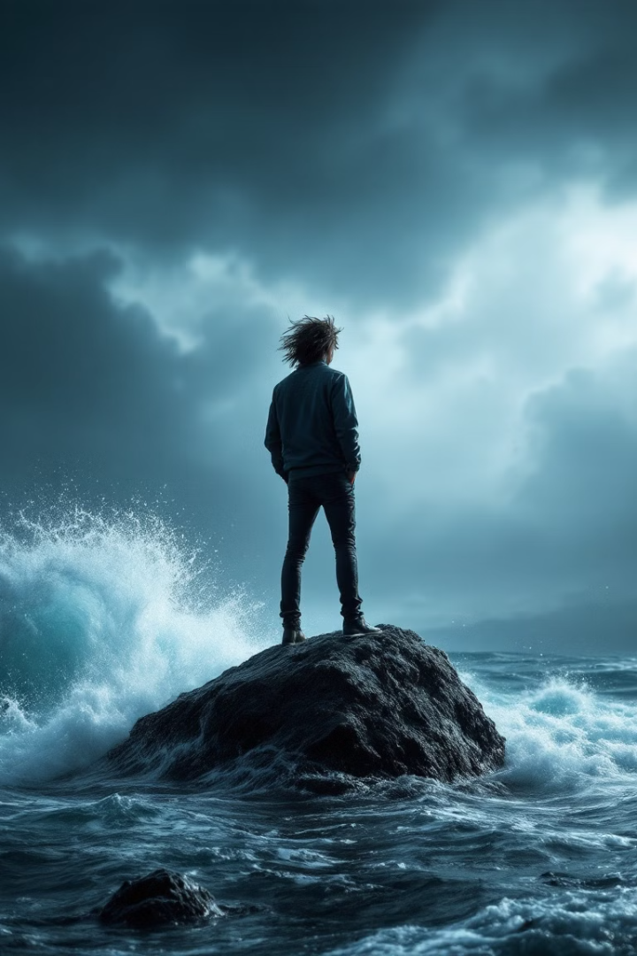
Psalm 56:3-4
When I am afraid, I put my trust in you. In God, whose word I praise, in God I trust; I shall not be afraid. What can flesh do to me?
Notes:
Psalm 56:3-4 reminds us that trust in God is our anchor in times of fear.

Slide 3
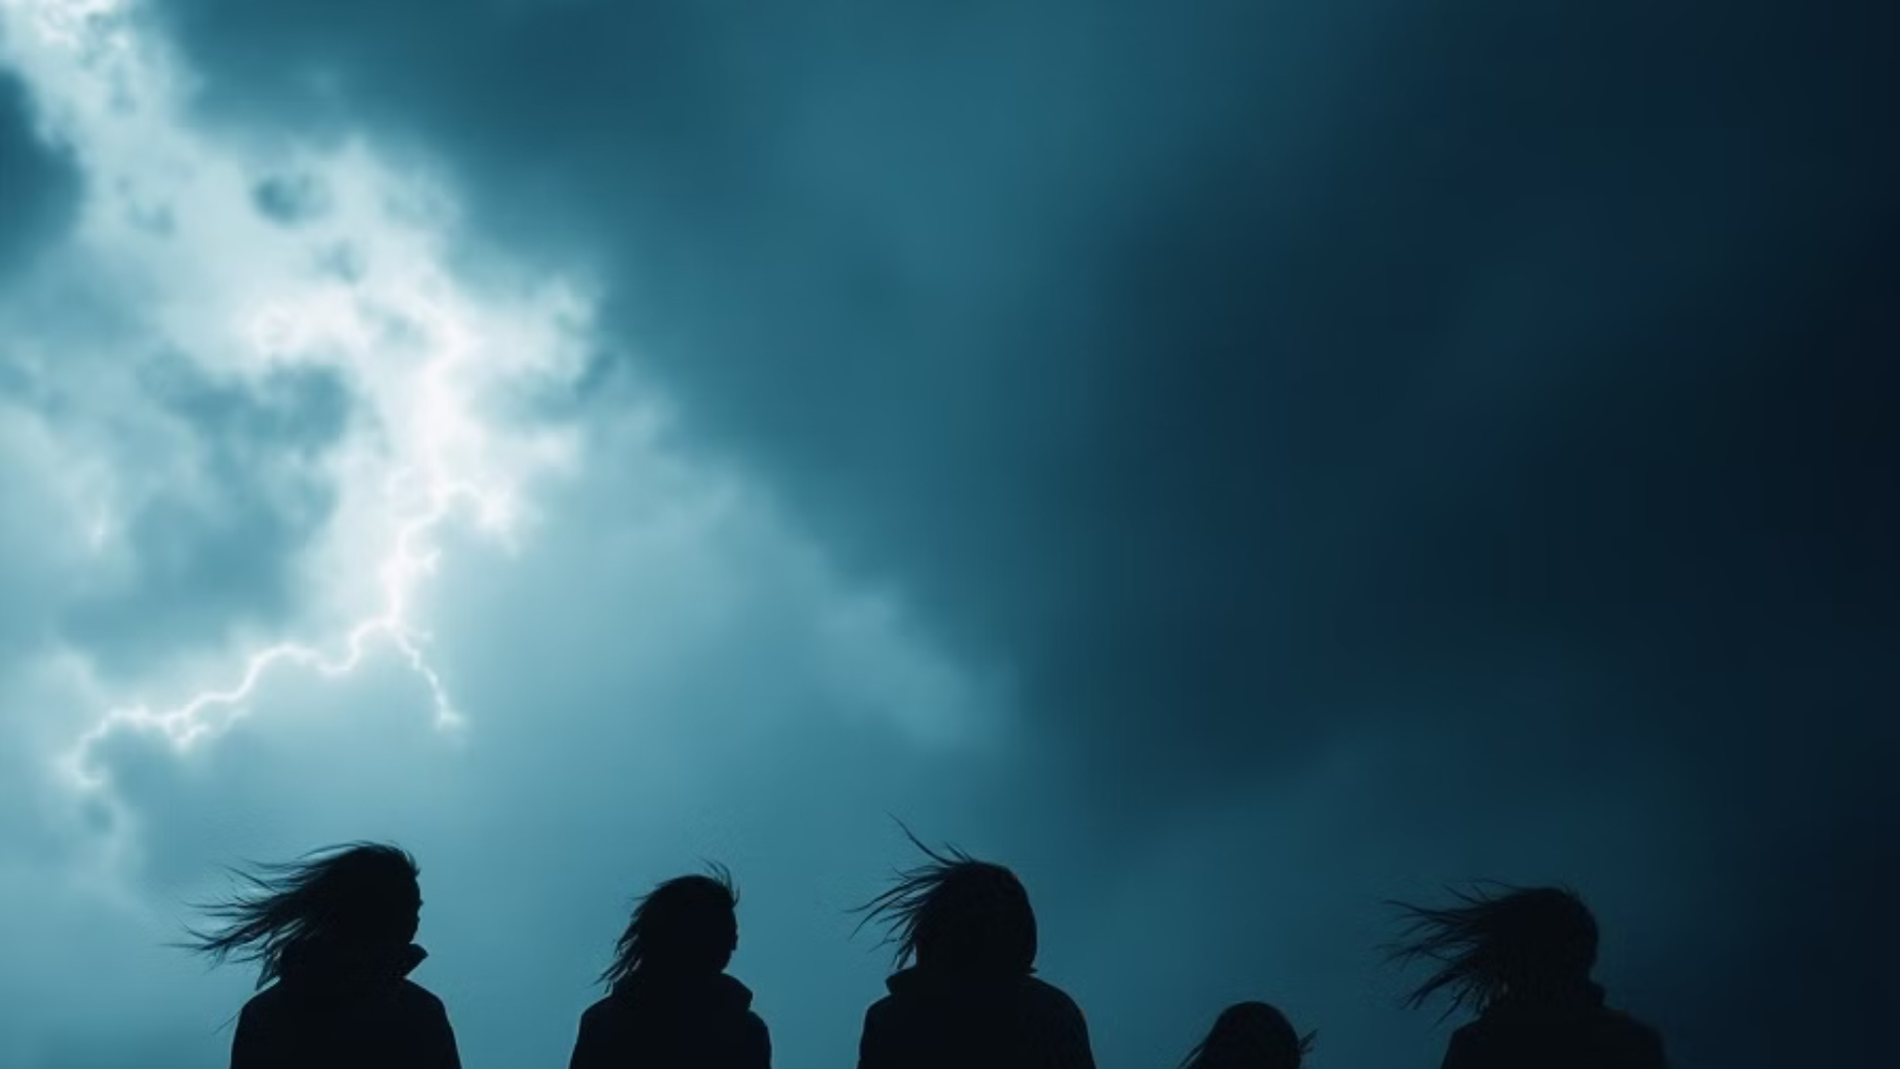
The Nature of Trust
Active Choice
Leaning on God
Trust is not passive; it's a deliberate decision to rely on God's promises.
We choose to depend on God's character, even when circumstances are challenging.
Notes:
Bridges explains that trust in God is an active choice, not a passive feeling. Trust involves a deliberate decision to rely on God's character and promises despite the circumstances one might face.
He contrasts human trust, which often depends on seeing, with spiritual trust in God, which must be exercised even when physical evidence is lacking.
Trust as an active choice, contrasting with passive feelings, involves leaning on God's character and promises
Proverbs 3:5-6 "Trust in the Lord with all your heart, and lean not on your own understanding"
Hebrews 11:1 "Now faith is the assurance of things hoped for, the conviction of things not seen."
Heb 13:5 "Never will i leave you, never will i forsake you."

Slide 4




Faith Beyond Sight
Physical Evidence ?
Spiritual Trust
Walking by Faith
Notes:
We often seek tangible proof in our daily lives.
Like Thomas we all doubt:John 20:24-25"Now Thomas, one of the twelve, called the Twin,[a] was not with them when Jesus came. So the other disciples told him, “We have seen the Lord.” But he said to them, “Unless I see in his hands the mark of the nails, and place my finger into the mark of the nails, and place my hand into his side, I will never believe.”
Faith calls us to trust beyond what we can see or touch.
Spiritual trust is necessary even when physical evidence is lacking
In reference to Moses;Hebrews 11:27" By faith he left Egypt, not being afraid of the anger of the king, for he endured as seeing him who is invisible."
We grow spiritually as we learn to trust without physical evidence.
2 Corinthians 5:7 "we walk by faith, not by sight"

Slide 5
Overcoming Trust Challenges
Self Determination
Facing Doubts
Trials and Suffering
Notes:
Challenges test our trust, but they also provide opportunities for growth and deeper faith.
Challenges like suffering and loss that test our trust
James 1:2-4; "Count it all joy, my brothers, ​when you meet trials of various kinds, for you know that the testing of your faith produces steadfastness. And let steadfastness have its full effect, that you may be perfect and complete, lacking in nothing”
Romans 5:3-5. " Not only that, but we rejoice in our sufferings, knowing that suffering produces endurance, and endurance produces character, and character produces hope, and hope does not put us to shame, because God's love has been poured into our hearts through the Holy Spirit who has been given to us."
God will never forsake you
1 Peter 5:7 “casting all your anxieties on him, because he cares for you.”
How these trials can lead to doubts and the need for spiritual determination to maintain trust
Psalm 42:5;
"Why are you cast down, O my soul, and why are you in turmoil within me?Hope in God; for I shall again praise him, my salvation​”
1 Peter 1:6-7 In this you rejoice, though now for a little while, if necessary, you have been grieved by various trials, 7 so that the tested genuineness of your faith—more precious than gold that perishes though it is tested by fire—may be found to result in praise and glory and honor at the revelation of Jesus Christ.
Another thing to be reminded of is that God must receive the honor due him. He is the object of our trust. He can work through or without the aid of man. If He does work through man we should be mindful that he is not dependent on man. We are to trust in God and not the instruments of his deliverance.

Slide 6

The daily circumstances of life will afford us opportunities enough of glorifying God in Trust, without our waiting for any extraordinary calls upon our faith.
Let us remember that the extraordinary circumstances of life are but few; that much of life may slip past without their occurrence, and that is we be not faithful and trusting in that which is little we are not likely to be so in that which is great…
Let our trust be reared in the humble nursery of our own daily experience, with its ever recurring little wants, and trials, and sorrows; and then, when need be, it will come forth, to do such great things as are required of it.
- Philip Bennet Power
Notes:
Don't rely on God just to get you through the most difficult of circumstances / greatest of crisises, but rather trust in him for all things, in all times.We as people have the tendency to seek the Lord, as we should, in our troubles. We must remember to be just as diligent in seeking Him and depending on Him through the minor troubles and in the day of abundance.

Slide 7
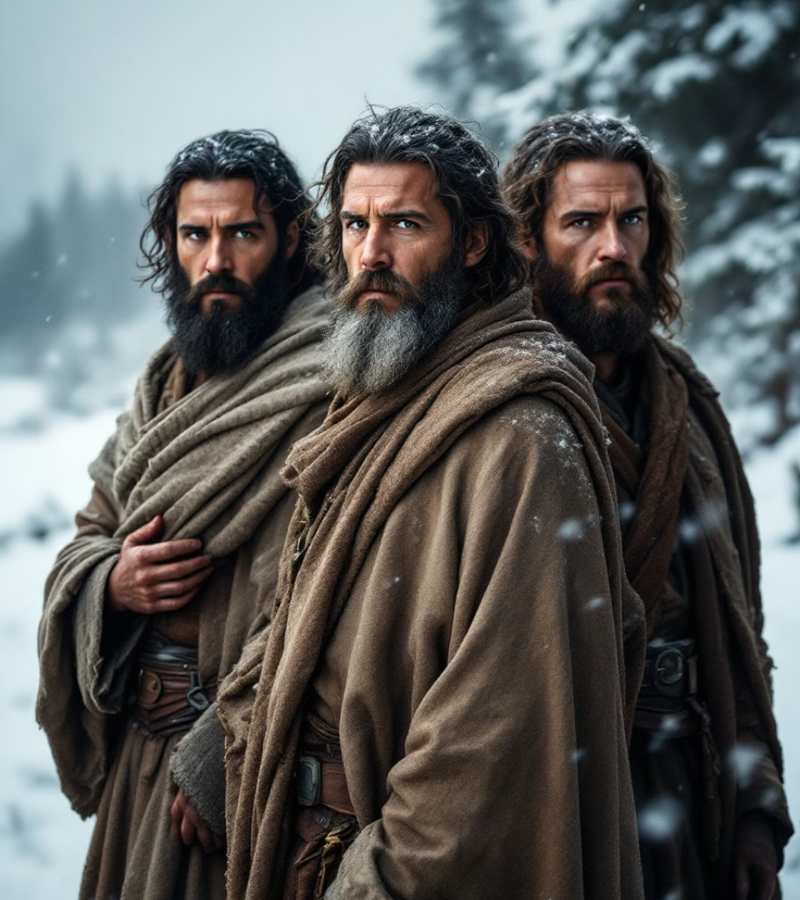



Biblical Trust
Abraham's Sacrifice
Job's Perseverance
David's Reliance
Notes:
Biblical Examples of Trust:
Willing to offer Isaac, demonstrating ultimate trust in God's plan.(Genesis 22:1-18),
After these things God tested Abraham and said to him, “Abraham!” And he said, “Here I am.” 2 He said, “Take your son, your only son Isaac, whom you love, and go to the land of Moriah, and offer him there as a burnt offering on one of the mountains of which I shall tell you.” 3 So Abraham rose early in the morning, saddled his donkey, and took two of his young men with him, and his son Isaac. And he cut the wood for the burnt offering and arose and went to the place of which God had told him. 4 On the third day Abraham lifted up his eyes and saw the place from afar. 5 Then Abraham said to his young men, “Stay here with the donkey; I and the boy[a] will go over there and worship and come again to you.” 6 And Abraham took the wood of the burnt offering and laid it on Isaac his son. And he took in his hand the fire and the knife. So they went both of them together. 7 And Isaac said to his father Abraham, “My father!” And he said, “Here I am, my son.” He said, “Behold, the fire and the wood, but where is the lamb for a burnt offering?” 8 Abraham said, “God will provide for himself the lamb for a burnt offering, my son.” So they went both of them together.
When they came to the place of which God had told him, Abraham built the altar there and laid the wood in order and bound Isaac his son and laid him on the altar, on top of the wood. 10 Then Abraham reached out his hand and took the knife to slaughter his son. 11 But the angel of the Lord called to him from heaven and said, “Abraham, Abraham!” And he said, “Here I am.” 12 He said, “Do not lay your hand on the boy or do anything to him, for now I know that you fear God, seeing you have not withheld your son, your only son, from me.” 13 And Abraham lifted up his eyes and looked, and behold, behind him was a ram, caught in a thicket by his horns. And Abraham went and took the ram and offered it up as a burnt offering instead of his son. 14 So Abraham called the name of that place, “The Lord will provide”;[b] as it is said to this day, “On the mount of the Lord it shall be provided.”[c]
15 And the angel of the Lord called to Abraham a second time from heaven 16 and said, “By myself I have sworn, declares the Lord, because you have done this and have not withheld your son, your only son, 17 I will surely bless you, and I will surely multiply your offspring as the stars of heaven and as the sand that is on the seashore. And your offspring shall possess the gate of his[d] enemies, 18 and in your offspring shall all the nations of the earth be blessed, because you have obeyed my voice.”
How did Abraham so trust to God?
Job’s perseverance:Maintained faith through immense suffering and loss. (Job 1:20-22; 13:15), Job 1:20-22 "Then Job arose and tore his robe and shaved his head and fell on the ground and worshiped. 21 And he said, “Naked I came from my mother's womb, and naked shall I return. The Lord gave, and the Lord has taken away; blessed be the name of the Lord.” In all this Job did not sin or charge God with wrong.” Job 13:15 “Though he slay me, I will hope in him”
David's reliance during his flight from Saul.Trusted God while fleeing from Saul, finding refuge in Him. 1 Samuel 24:15; "May the Lord therefore be judge and give sentence between me and you, and see to it and plead my cause and deliver me from your hand"Psalm 57:1"Be merciful to me, O God, be merciful to me,for in you my soul takes refuge;in the shadow of your wings I will take refuge,till the storms of destruction pass by."Ps 27:1-5"The Lord is my light and my salvation—whom shall I fear?The Lord is the stronghold of my life—of whom shall I be afraid?When the wicked advance against meto devour[a] me,it is my enemies and my foeswho will stumble and fall.Though an army besiege me,my heart will not fear;though war break out against me,even then I will be confident. One thing I ask from the Lord,this only do I seek:that I may dwell in the house of the Lordall the days of my life,to gaze on the beauty of the Lordand to seek him in his temple.For in the day of troublehe will keep me safe in his dwelling;he will hide me in the shelter of his sacred tentand set me high upon a rock."
These accounts serve as models for trusting God in crises (Psalm 56:3-4).
Can you think of any other people in scripture who chose to trust God despite their emotions?

Slide 8
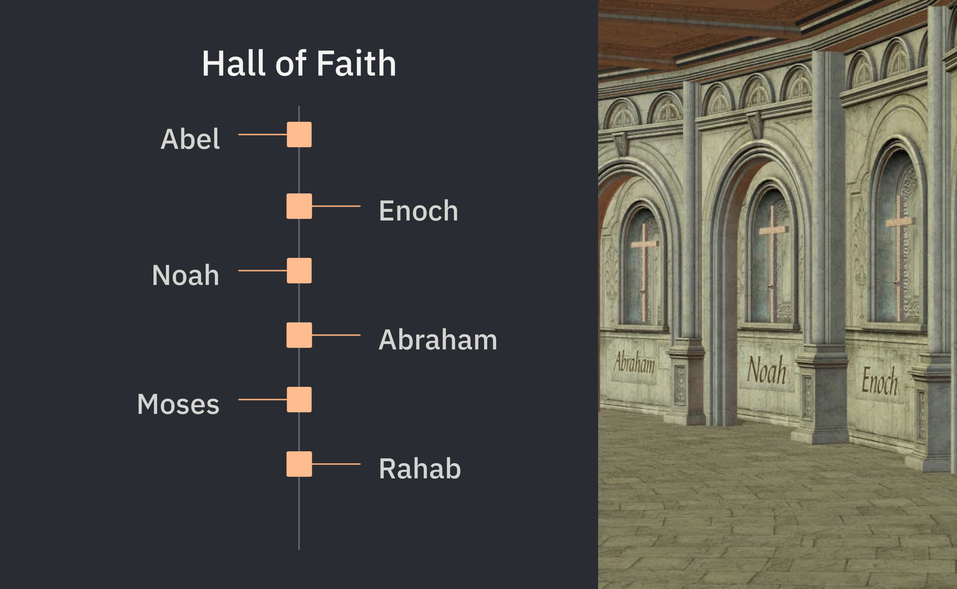


Hall of Faith
Notes:
HE Explores the deep connection between faith and trust, explaining their theological and practical significance
The Role of Faith in Trust:Hit on heb 11 hall of faith. Abel /Enoch / Noah v4-7 / Moses / Rahab / v23-31
By faith Abel offered to God a more acceptable sacrifice than Cain, through which he was commended as righteous, God commending him by accepting his gifts. And through his faith, though he died, he still speaks. ⁵ By faith Enoch was taken up so that he should not see death, and he was not found, because God had taken him. Now before he was taken he was commended as having pleased God. ⁶ And without faith it is impossible to please him, for whoever would draw near to God must believe that he exists and that he rewards those who seek him. ⁷ By faith Noah, being warned by God concerning events as yet unseen, in reverent fear constructed an ark for the saving of his household. By this he condemned the world and became an heir of the righteousness that comes by faith.
Heb 11:32-38
And what more shall I say? For time would fail me to tell of Gideon, Barak, Samson, Jephthah, of David and Samuel and the prophets— ³³ who through faith conquered kingdoms, enforced justice, obtained promises, stopped the mouths of lions, ³⁴ quenched the power of fire, escaped the edge of the sword, were made strong out of weakness, became mighty in war, put foreign armies to flight. ³⁵ Women received back their dead by resurrection. Some were tortured, refusing to accept release, so that they might rise again to a better life. ³⁶ Others suffered mocking and flogging, and even chains and imprisonment. ³⁷ They were stoned, they were sawn in two,^{[a]} they were killed with the sword. They went about in skins of sheep and goats, destitute, afflicted, mistreated— ³⁸ of whom the world was not worthy—wandering about in deserts and mountains, and in dens and caves of the earth.
Faith and trust form the bedrock of our relationship with God.
Ephesians 2:8-9; "For by grace you have been saved through faith. And this is not your own doing; it is the gift of God, 9 not a result of works, so that no one may boast."
Hebrews 11:6 " And without faith it is impossible to please him, for whoever would draw near to God must believe that he exists and that he rewards those who seek him."
Living out our faith requires active trust in God's promises.
Discusses how trust and faith are foundational to the Christian experience
Galatians 2:20 "I have been crucified with Christ. It is no longer I who live, but Christ who lives in me. And the life I now live in the flesh I live by faith in the Son of God, who loved me and gave himself for me."
2 Timothy 1:12 "which is why I suffer as I do. But I am not ashamed, for I know whom I have believed, and I am convinced that he is able to guard until that day what has been entrusted to me.​"

Slide 9

Practical Steps to Deepen Trust
Regular Prayer
Scripture Meditation
Recounting God's Faithfulness
Notes:
Practical Steps to Trust God:
Consistent communication with God builds a foundation of trust.
Philippians 4:6-7"do not be anxious about anything, but in everything by prayer and supplication with thanksgiving let your requests be made known to God. 7 And the peace of God, which surpasses all understanding, will guard your hearts and your minds in Christ Jesus."
Ps 55:17"Evening and morning and at noon I utter my complaint and moan,and he hears my voice."
BE IN HIS WORD: Dwelling on God's Word reinforces His faithfulness and promises.
Joshua 1:8"This Book of the Law shall not depart from your mouth, but you shall meditate on it day and night, so that you may be careful to do according to all that is written in it. For then you will make your way prosperous, and then you will have good success
."Deut 11:18-20“You shall therefore lay up these words of mine in your heart and in your soul, and you shall bind them as a sign on your hand, and they shall be as frontlets between your eyes. 19 You shall teach them to your children, talking of them when you are sitting in your house, and when you are walking by the way, and when you lie down, and when you rise. 20 You shall write them on the doorposts of your house and on your gates"
Recounting God’s past faithfulness as a tool to bolster trust during current trials. Remembering past blessings bolsters trust during current trials.
Psalm 77:11-12; "I will remember the deeds of the Lord; yes, I will remember your wonders of old. I will ponder all your work, and meditate on your mighty deeds."
Lamentations 3:21-23"But this I call to mind, and therefore I have hope: The steadfast love of the Lord never ceases; his mercies never come to an end; 23 they are new every morning; great is your faithfulness."

Slide 10




The Benefits of
Trusting God
Peace of Mind
Spiritual Growth
Spiritual Armor
Notes:
The Benefits of Choosing to Trust God:
Outlines benefits like peace of mind, spiritual growth, and a deeper awareness of God’s presence
Isaiah 26:3"You keep him in perfect peace whose mind is stayed on you,because he trusts in you.”
Psalm 32:10"Many are the sorrows of the wicked,but steadfast love surrounds the one who trusts in the Lord"
Encourages viewing trust as spiritual armor against life's uncertainties
Ephesians 6:16"16 In all circumstances take up the shield of faith, with which you can extinguish all the flaming darts of the evil one;"
Psalm 28:7"The Lord is my strength and my shield; in him my heart trusts, and I am helped; my heart exults, and with my song I give thanks to him."

Slide 11

A Call to Trust
Grow
Equip
Decide
Notes:
Urges readers to actively decide to trust God in all life aspects Make an active choice to trust God in all aspects of life.
joshua 24:15b "But as for me and my house, we will serve the Lord"
Mark 5:36"But overhearing[a] what they said, Jesus said to the ruler of the synagogue, “Do not fear, only believe.”
Equip: Use trust as part of your spiritual armor against doubts and fears.
Emphasizes trust as part of the believer's spiritual armor
Psalm 91:4
“He will cover you with his pinions,
and under his wings you will find refuge;
his faithfulness is a shield and buckler.”
2 Corinthians 10:4-5
”For the weapons of our warfare are not of the flesh but have divine power to destroy strongholds. ⁵ We destroy arguments and every lofty opinion raised against the knowledge of God, and take every thought captive to obey Christ,”
Grow: Allow your trust to deepen your relationship with God daily.

